Slide 1

NORTH OAKS
TRAFFIC CALMING DISCUSSIONS FOLLOW UP
July 14, 2022 – City Council
Presented by: John Morast, PE – HR Green Regional Director

Slide 2
Traffic Calming Agenda
Traffic Calming Recap
  Complaints, Speeding, Safety Forum
  Typical traffic calming types
Potential Traffic Calming Locations
  Identified from aerial phots
  Drove City and sites to review locations, notes
  Possible additional locations
Priority Locations
Potential Temporary Traffic Calming Features
Additional Locations or Types
Next Steps

Slide 3
Traffic Calming Recap
Traffic Calming Recap
  City Receives Speeding and Violation Complaints
  Deployment of County Speed Trailer
  Rapp Farm Community Meeting
    Traffic calming, speed and safety meeting
  Community Safety Forum Meeting
  Traffic Calming Follow Up
  Education, Enforcement, Engineering

Slide 4
Potential Traffic Calming Locations
Potential Traffic Calming Locations
  Identified from aerial phots
  Drove City and sites to review locations, notes
  Possible additional locations

Slide 5
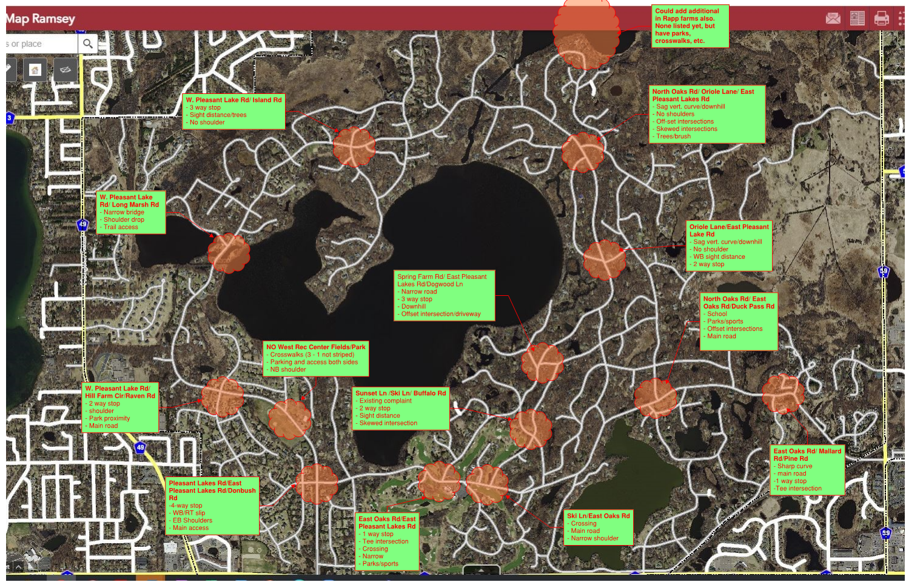

Slide 6
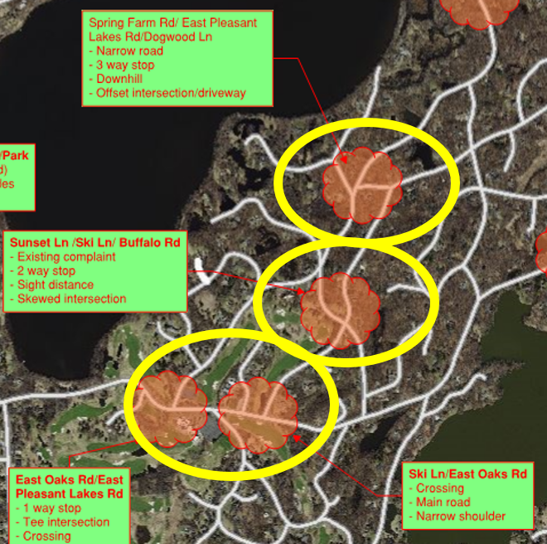
Potential Priority Calming Locations
Potential Traffic Calming Locations
  Spring Farm Rd/E. Pleasant Lakes Rd/Dogwood Ln
  Sunset Ln/Ski Ln/Buffalo Rd
  East Oaks Rd/E. Pleasant Lakes Rd
  Ski Ln/E. Oaks Rd

Slide 7
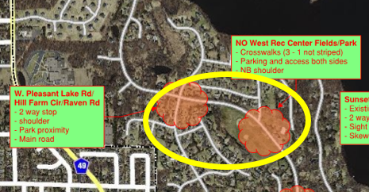
Potential Priority Calming Locations
Potential Traffic Calming Locations
  North Oaks West Rec Center Fields/Park
  W. Pleasant Lake Rd/Hill Farm Rd/Raven Rd

Slide 8
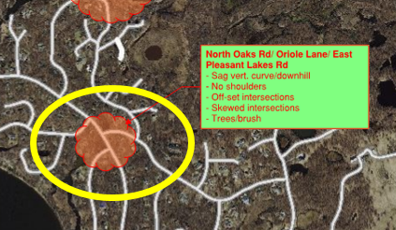
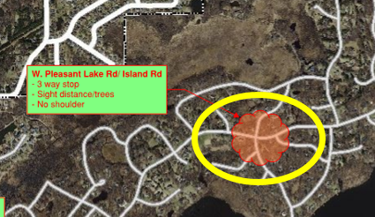
Potential Priority Calming Locations
Potential Traffic Calming Locations
  North Oaks Rd/Oriole Ln/Pleasant Lakes Rd
  W. Pleasant Lakes Rd/Island Rd

Slide 9
Traffic Calming

Slide 10
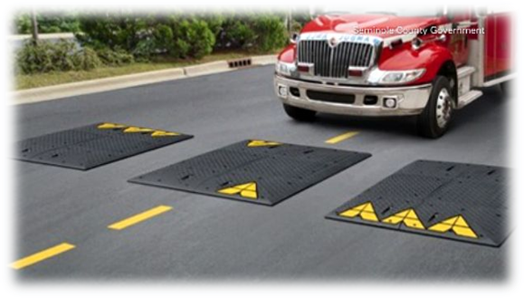
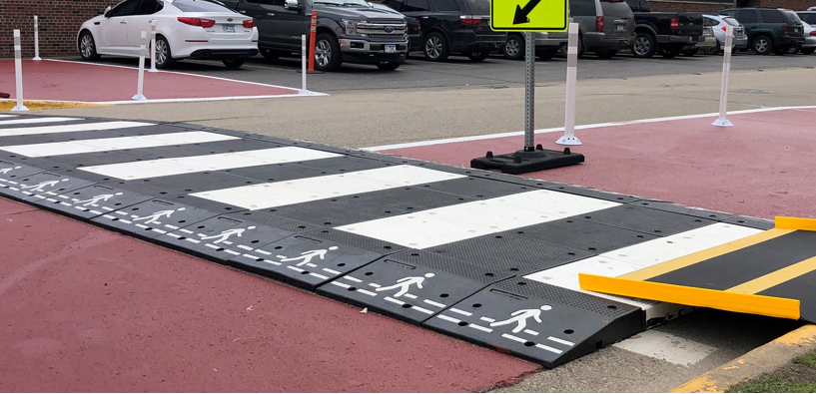
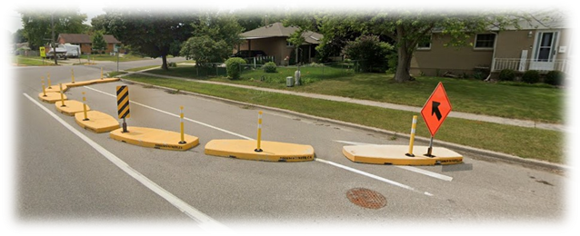
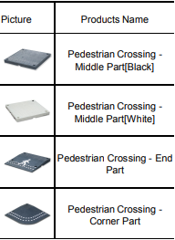
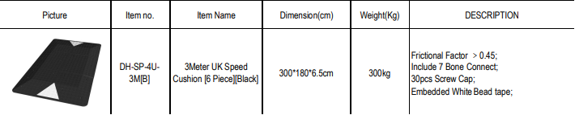
Temporary Traffic Calming
Modular Temporary Traffic Calming
  Ramps, crossing sections, pylons, signs, etc.
  Mix and match to create desired treatment

Slide 11
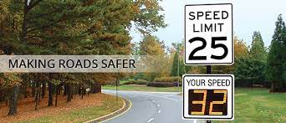
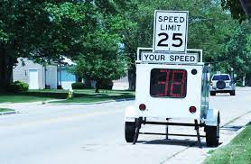
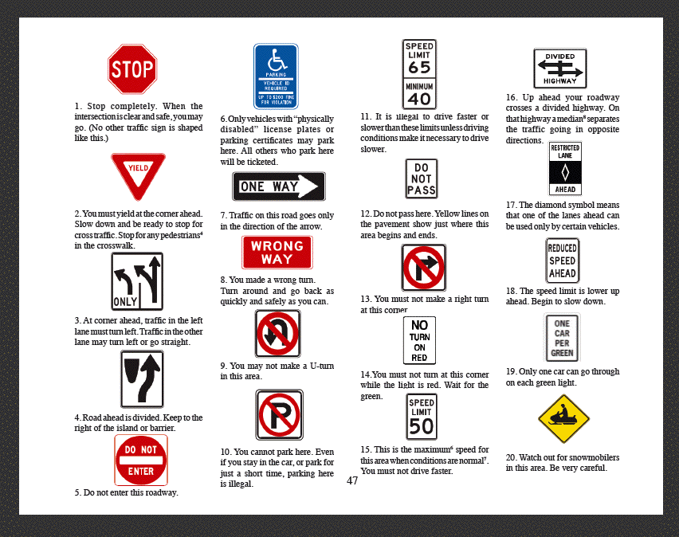

Education

Slide 12
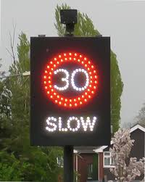
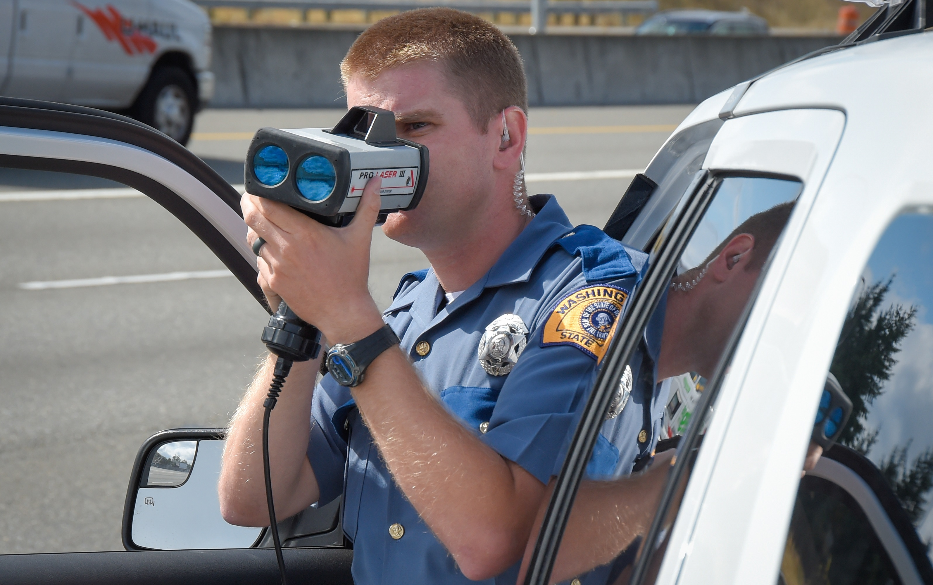
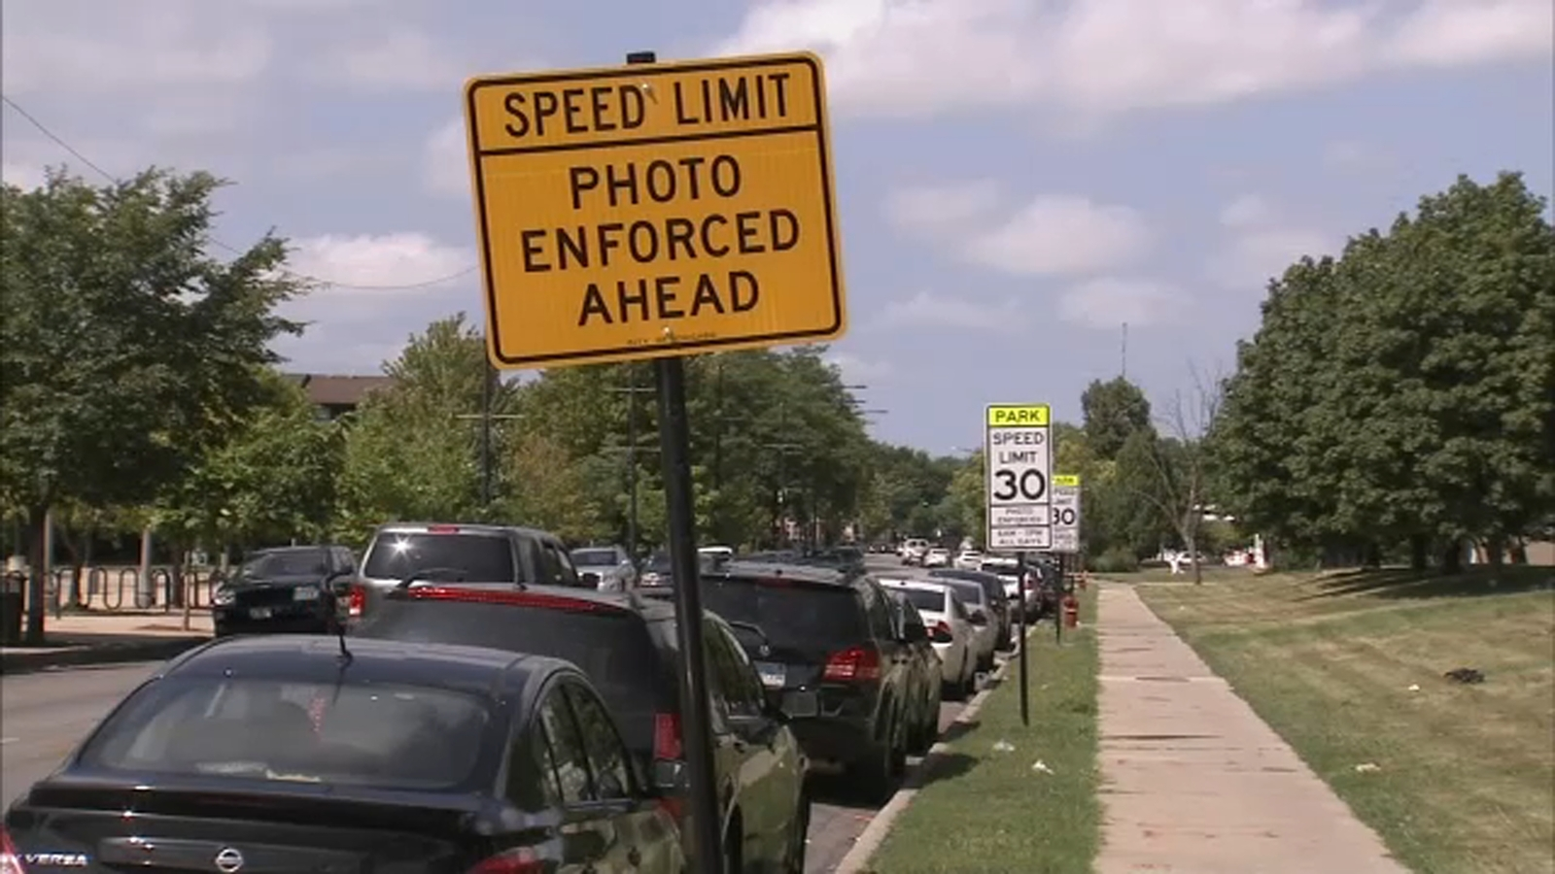
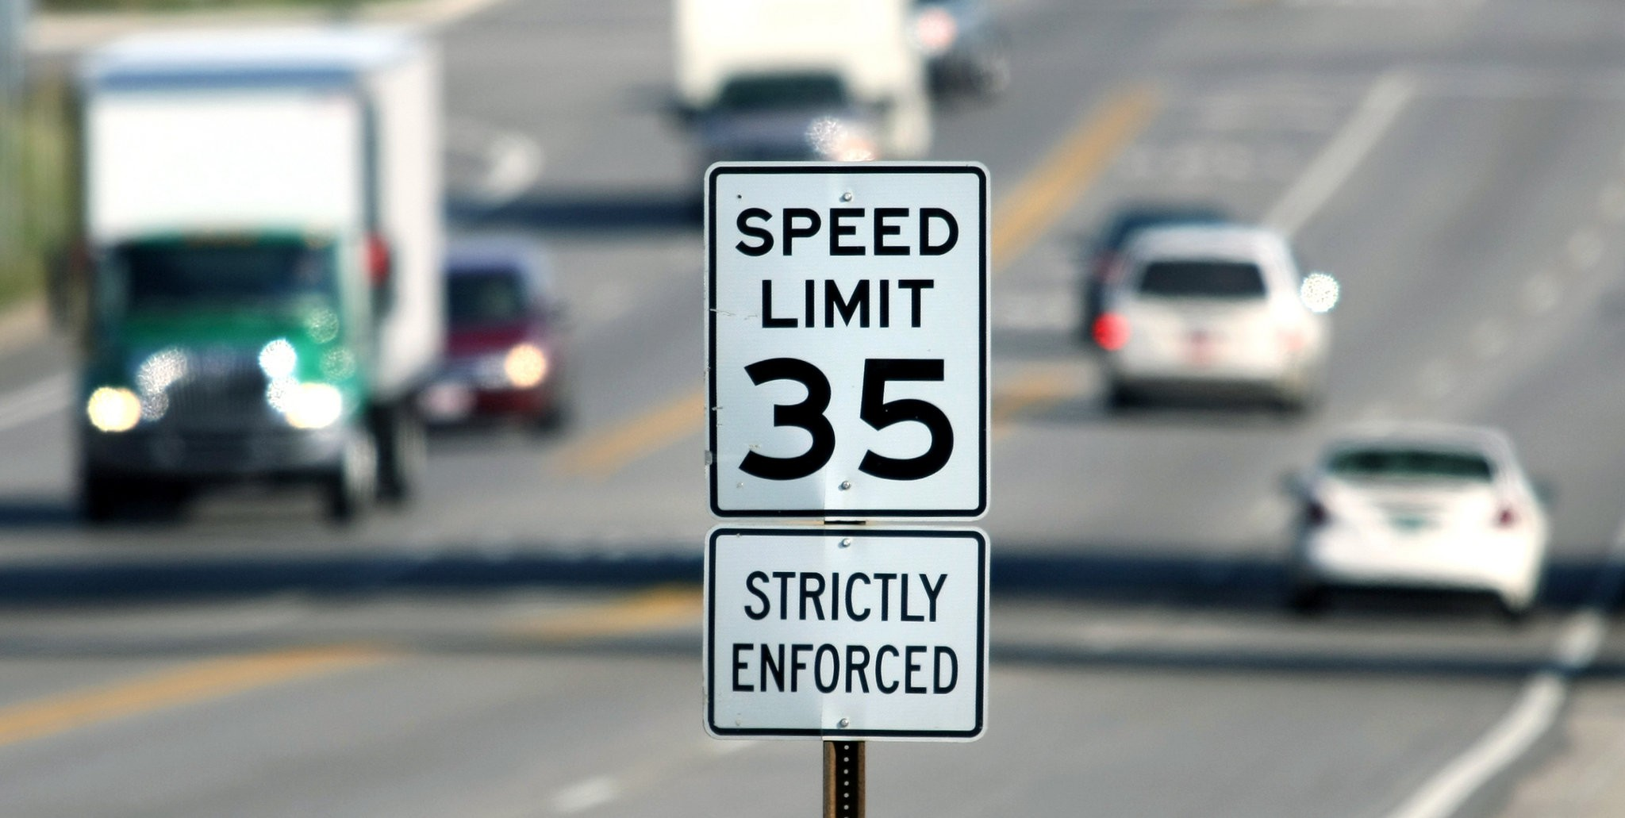
Enforcement

Slide 13
Additional Discussions/ Next Steps
Any additional Locations
Additional Traffic Calming Measures
Ideas on Outcomes
Next Steps/Direction

Slide 14
Next Steps
Any additional Locations
Additional Traffic Calming Measures
Ideas on outcomes

Slide 15
QUESTIONS

Slide 17
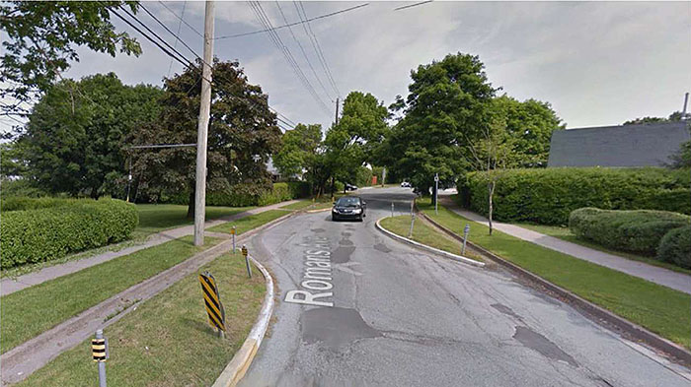
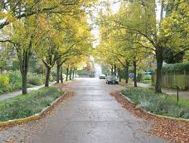
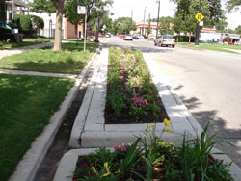
Engineering -
Traffic Calming

Slide 18
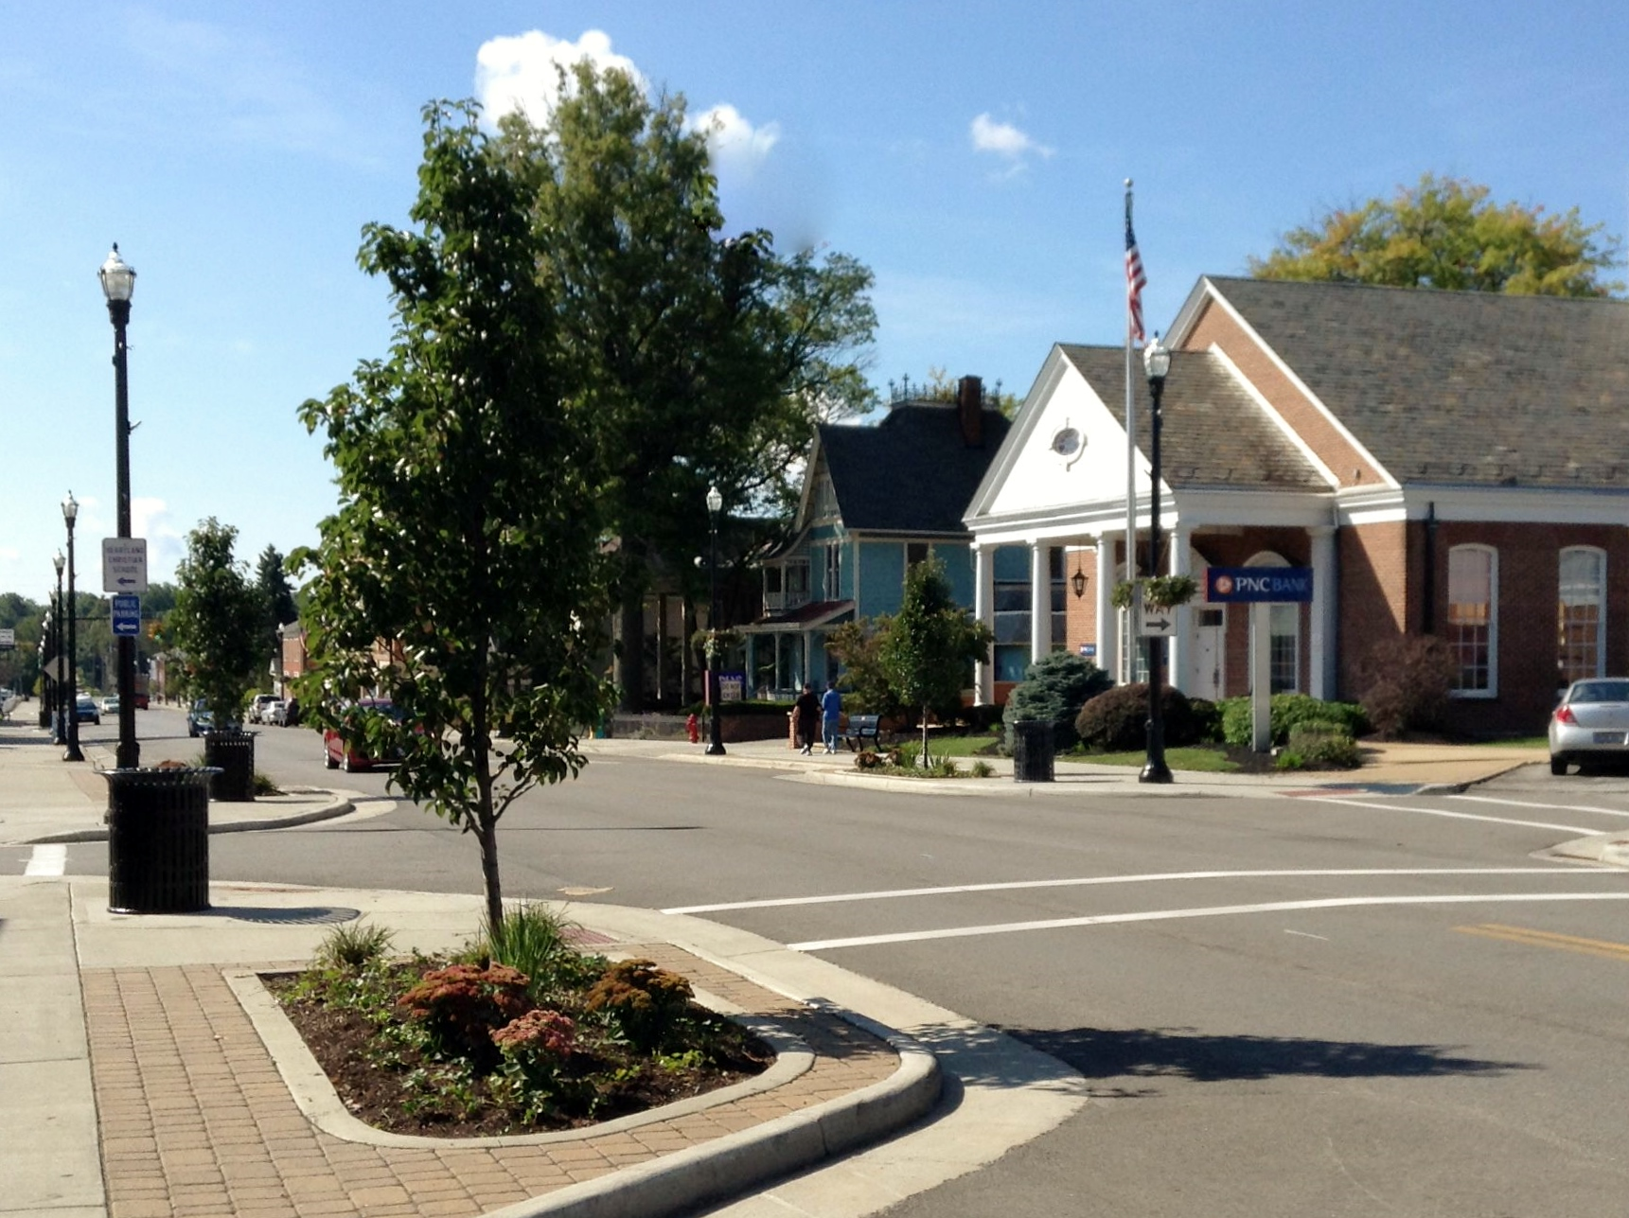
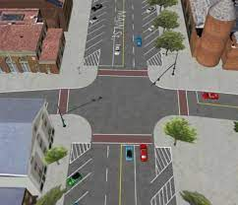
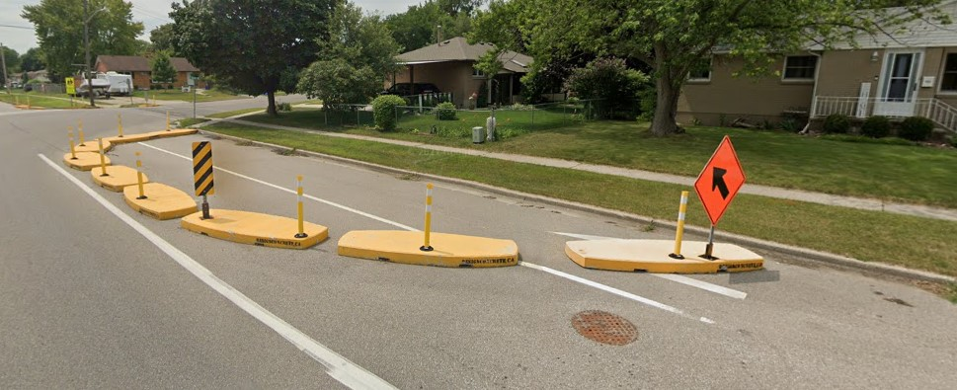
Engineering -
Traffic Calming

Slide 19
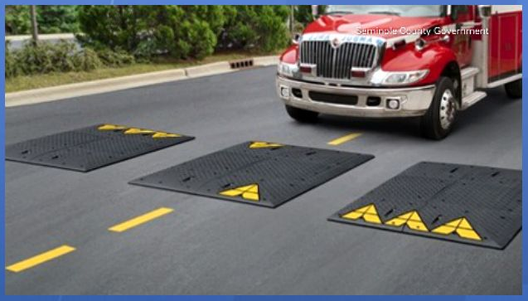
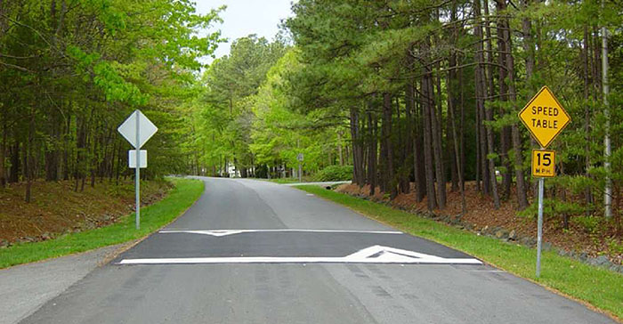
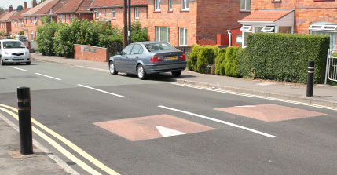
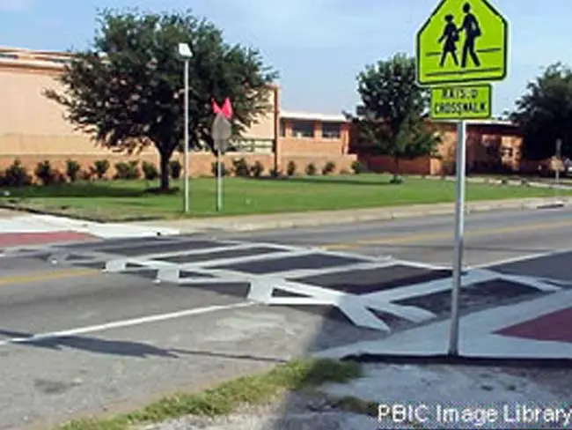
Engineering –
Traffic Calming

