Slide 1
North Oaks Safety & Security Initiative
License Plate Recognition (LPR)
Pilot

Slide 2
High Level Questions
What is LPR technology?
LPR technology allows for the automated detection of license plates.
It is used by law enforcement on official business to convert data associated with vehicle license plates.
The data is associated with stolen vehicles, missing persons, suspect interdiction, and recovery of stolen property.
What does LPR record/not record?
LPR cameras capture the make, model, and license plate of a vehicle.
LPR cameras/systems DO NOT record or store any data associated with the occupants of the vehicle.
LPR cameras/systems DOES NOT contain information associated with the address of the vehicle.
What are the benefits of an LPR system?
LPR can be a powerful deterrent which can prevent criminals from coming further into the community.
LPR is an important tool to assist law enforcement in arresting and prosecuting criminals.
LPR can alert law enforcement immediately when a stolen vehicle has entered the community.

Slide 3
Where will the LPR cameras go?
N
Rapp Farm Blvd.
Monarch Way
North Oaks
Wildflower Way
E. Oaks Rd.
Pleasant Lake Rd.
E. Gilfillan Rd.
= two (2) cameras (one ingress, one egress) – 12 total cameras
= sites selected for pilot due to daily volume of ingress/egress traffic

Slide 4
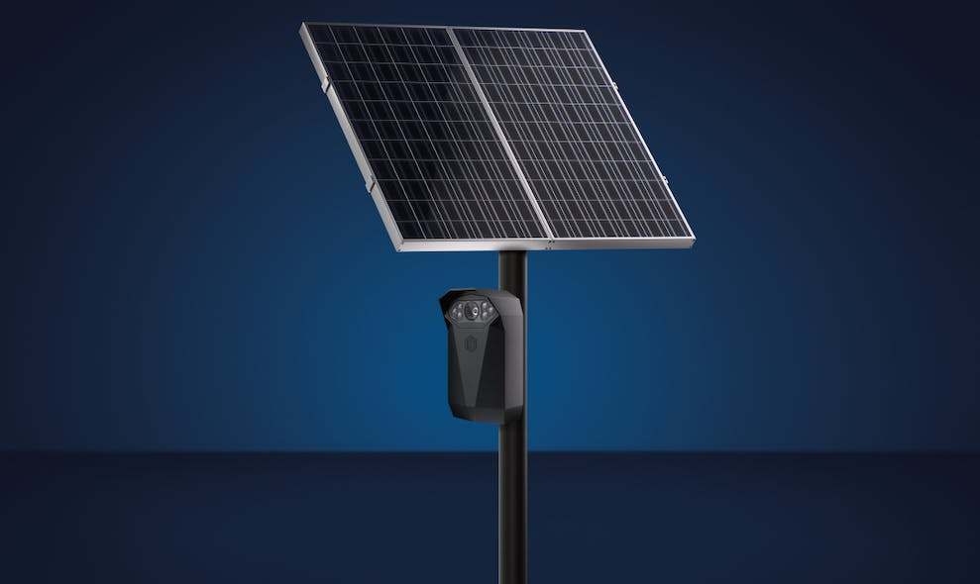
LPR System - Genetec AutoVu Cloudrunner
12 units to cover identified entrances to the community
Initial Installation cost
$4,760
Per unit cost annually
$2,495
Year 1 Investment
$34,700
Annual Investment after year 1
$29,940
Pricing does not include pole installation & taxes
https://www.genetec.com/products/unified-security/autovu/cloudrunner

